Slide 1
Project 1, Module 6
Lucas Ross

Slide 2
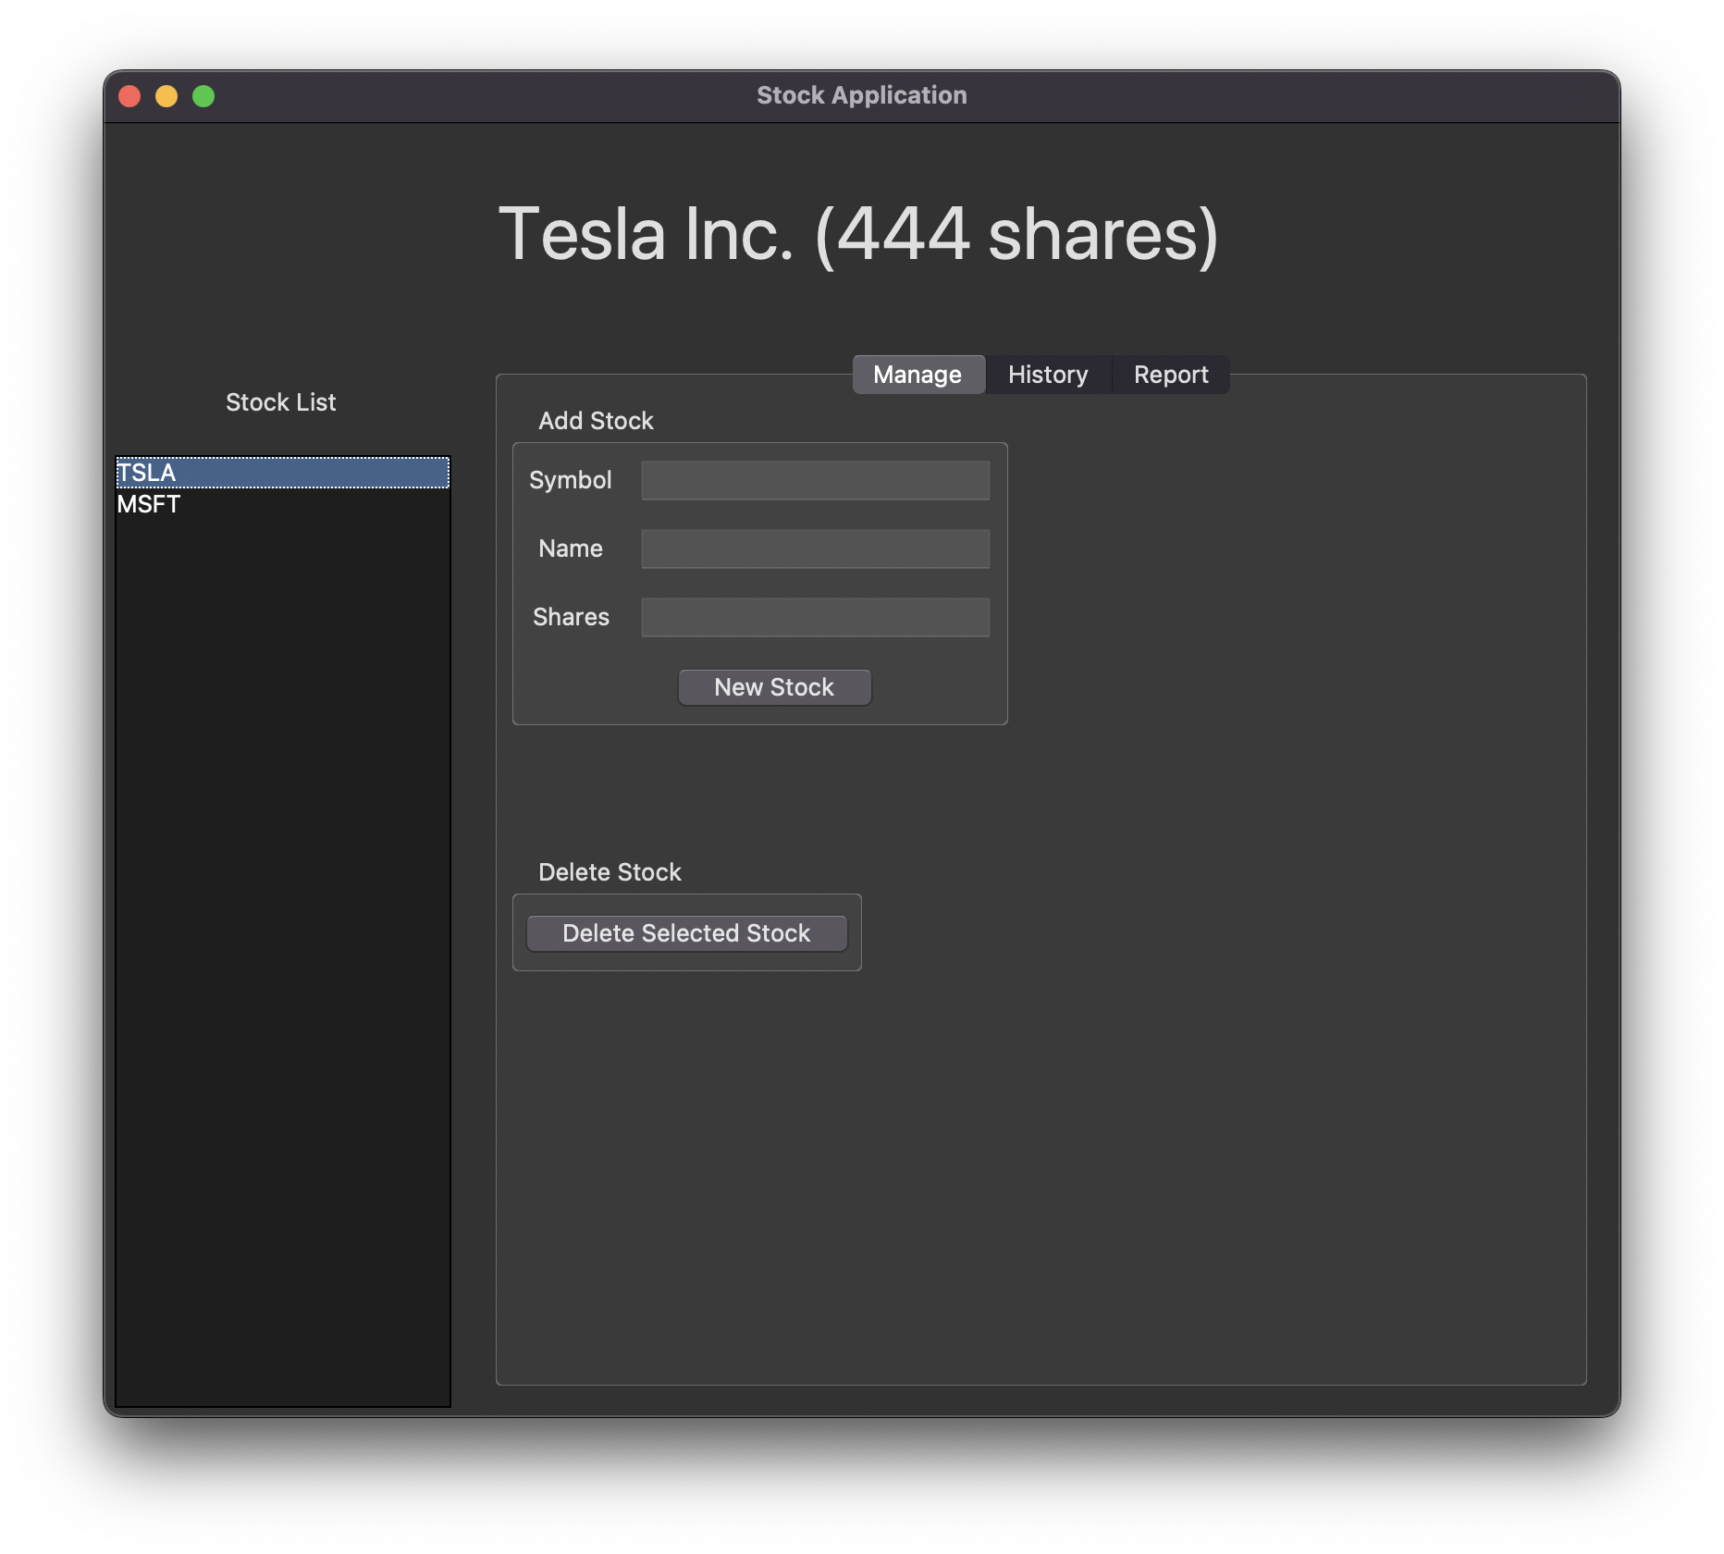
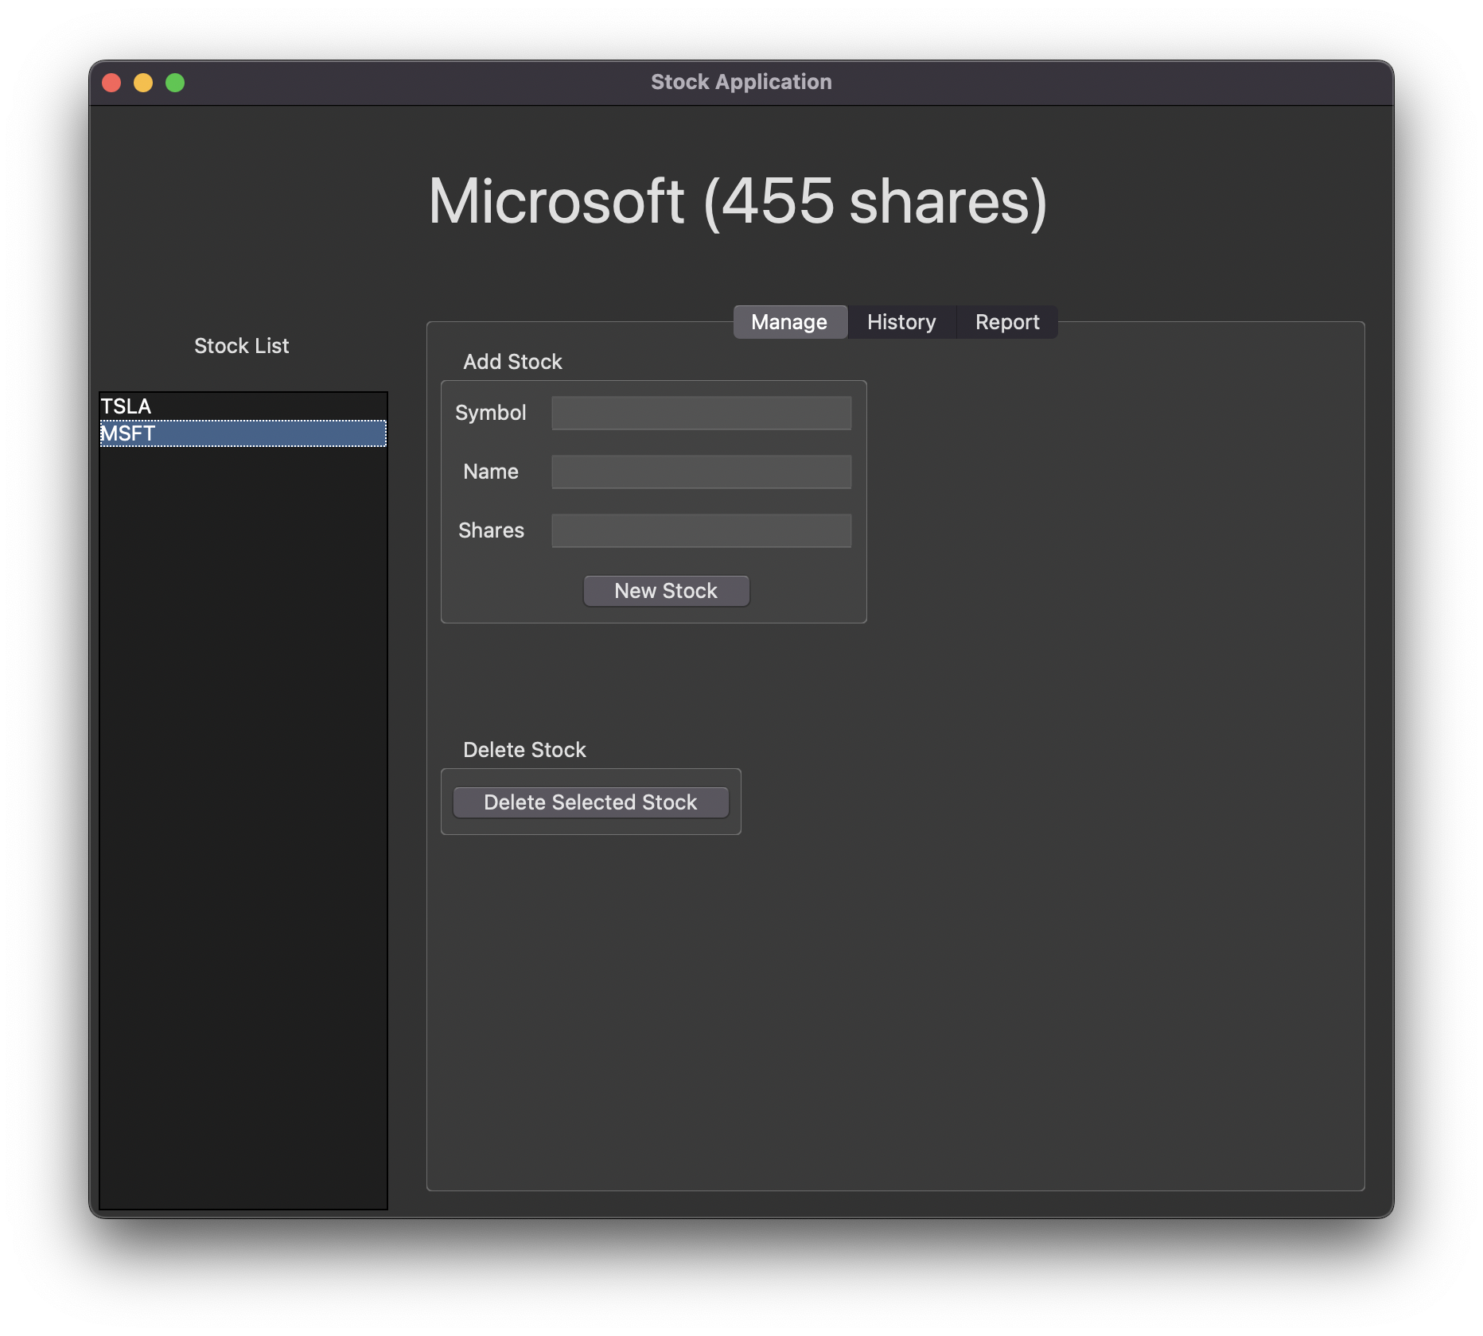
Creating Two Stocks
Two stocks are created using the Manage tab and are displayed in the Stock List:
[TSLA] Tesla Inc. (444 shares)
[MSFT] Microsoft (455 shares)

Slide 3
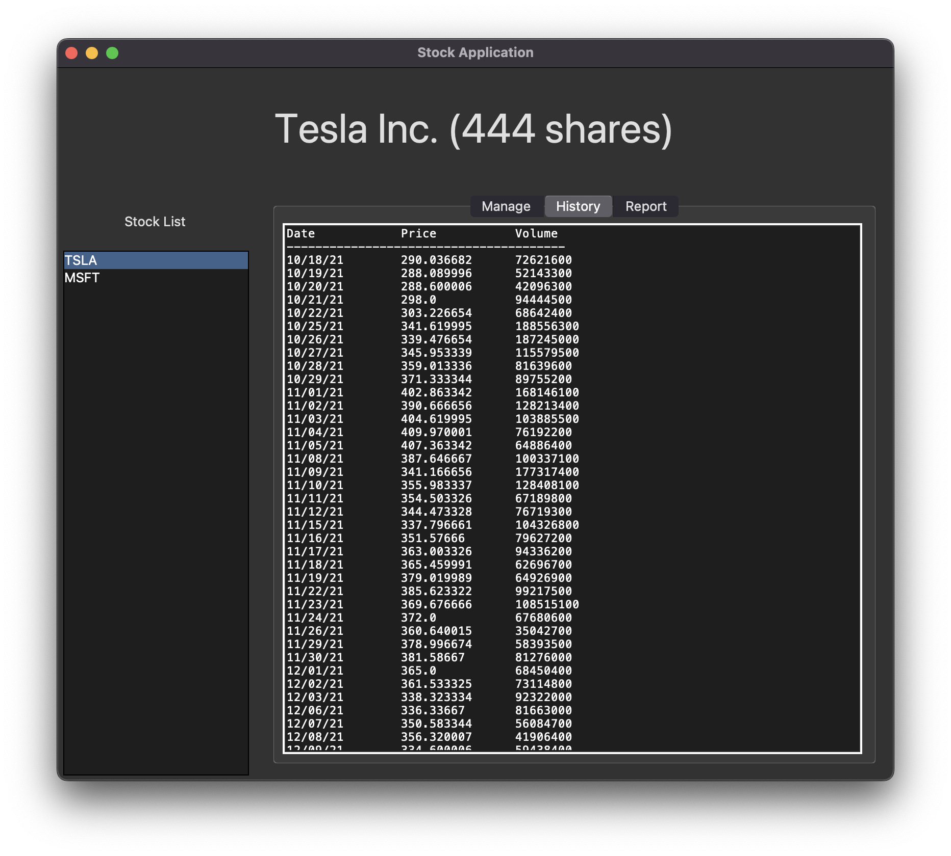
CSV Data Import
The records from 10/18/21 to 10/18/22 are imported through a CSV file from Yahoo! Finance. The data is added to the Daily Data list of [TSLA].
The raw Daily Data can be seen in the History tab.

Slide 4
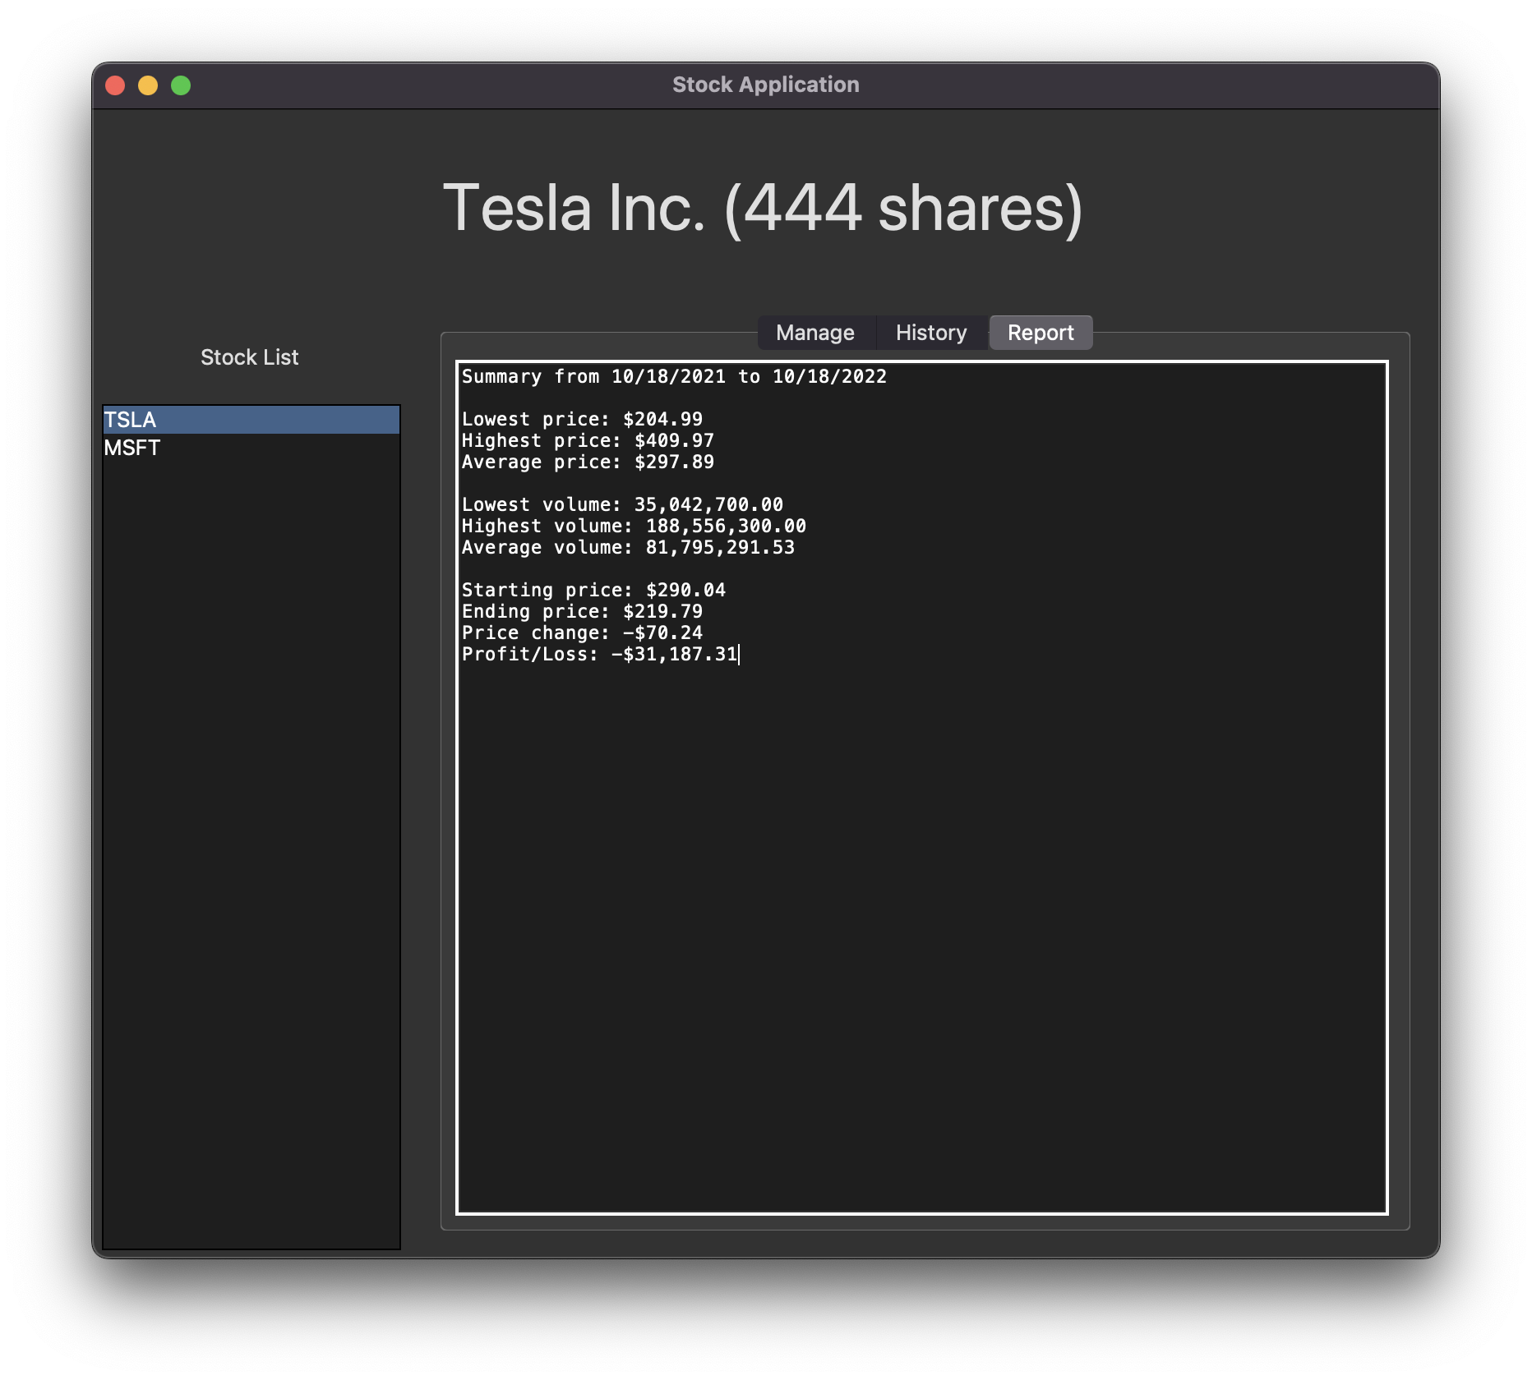
CSV Data Import
A summary of the data imported in the previous slide can be seen in the Report tab.

Slide 5
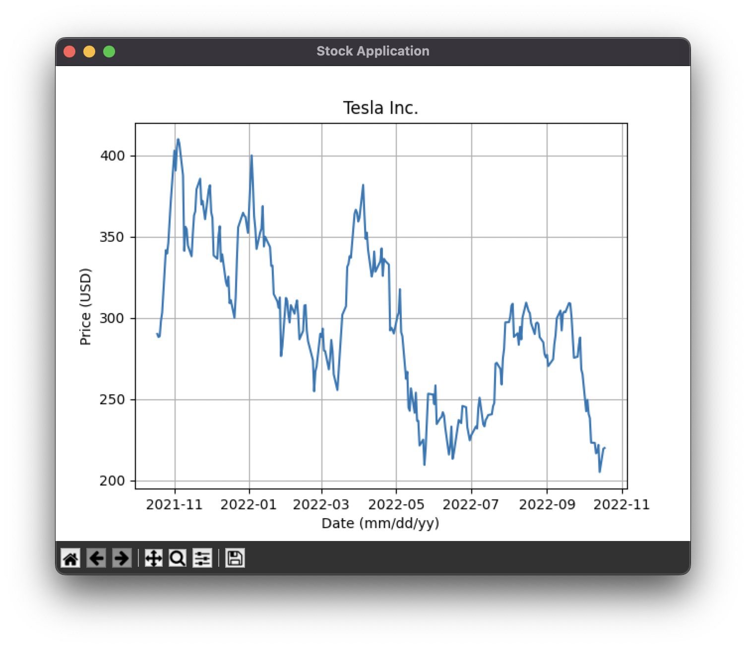
Chart Display
The CSV data imported in one of the previous slides is plotted on a line graph with matplotlib.

